Slide 1

Drake University
October 2024

Slide 2
The Conversation is a nonprofit
independent news organization.
Our mission
Promote accurate information and strengthen journalism by unlocking the rich diversity of academic research for audiences across America
theconversation.com
Notes:
The Conversation U.S. is a nonprofit news organization is a nonprofit, independent publisher of expert research and news analysis. Founded in Australia in 2011, we are part of a global network of sister sites in nine countries, including the U.K., Spain, France, Canada, Indonesia, Africa and New Zealand. The Conversation U.S. is based in Boston, though we have staff across the country, and was launched in 2014.
Our mission is to promote truthful information and strengthen journalism by sharing academic research with the general public. More succinctly put: We seek to democratize knowledge for the public good. Our goal is to make the knowledge and research at universities and colleges accessible to the general public, producing explanatory journalism that helps to make news more accessible.
We are funded by a combination of university members, including “xxx”; support from foundations and individual donations.

Slide 3

Written by academic experts, edited
by journalists, for the general public
Experts write explanatory journalism pieces (not op-eds) within their area of expertise.
Editors assign, help frame and edit stories, providing authors with the skills to bring their expertise to a wider audience.
Articles are free to read and free to republish through a Creative Commons license.
In 2023, our stories averaged 14 million monthly pageviews.
Our stories + editorial model
Notes:
All of our stories are written by academic experts and edited by our team of journalists for the general public. We publish only original pieces that have not been published elsewhere. 8-10 articles daily, or 40-60 weekly
Want to represent a diversity of views, nonpartisan
Academic experts write explanatory journalism pieces within their specific area of expertise for a variety of desks, including Arts + Culture, Politics + Society, Education, Economy + Business, Science + Tech and others. As opposed to op-eds or advocacy pieces, our stories emphasis facts, figures and research, which is why we call them explanatory journalism. Our editors work closely with academics in a collaborative process to ensure that all stories are accessible, informative and of interest to a general reader.
Our articles are free to read and free to republish through a Creative Commons license, which means that stories are picked up by outlets ranging from community newspapers to national and international outlets, like The Washington Post, CNN, TIME, Newsweek, Scientific American and Univision. We also partner with The Associated Press, which sends our stories over its wire every day, and Yahoo! News and Apple News.
In 2022, our stories averaged 17 million monthly reads on our site at theconversation.com and through online republishers.

Slide 4
We publish 40-60 stories a week
Stories are 600-1,000 words in length, some even shorter
Shorter formats including Research Briefs, Curious Kids, Picture in 500 words, and more.
Once a story is published on our site, it is published on the AP Wire, Apple News, and pushed out to our republishers by our audience team.
The basics
Notes:
All of our stories are written by academic experts and edited by our team of journalists for the general public. We publish only original pieces that have not been published elsewhere.
Academic experts write explanatory journalism pieces within their specific area of expertise for a variety of desks, including Arts + Culture, Politics + Society, Science + Tech, Health + Medicine, Economy + Business, and others. As opposed to op-eds or advocacy pieces, our stories emphasis facts, figures and research, which is why we call them explanatory journalism. Our editors work closely with academics in a collaborative process to ensure that all stories are accessible, informative and of interest to a general reader.
Our articles are free to read and free to republish through a Creative Commons license, which means that stories are picked up by outlets ranging from community newspapers to national and international outlets, like The Washington Post, CNN, TIME, Newsweek, Scientific American and Univision. We also partner with The Associated Press, which sends our stories over its wire every day, and Yahoo! News and Apple News.
In 2022, our stories averaged 17 million monthly reads on our site at theconversation.com and through online republishers.

Slide 5
Arts + Culture
Economy + Business
Education
Environment + Energy
Ethics + Religion
Health + Medicine
Philanthropy + Nonprofits
Politics + Society
Science + Technology
International
Our desks
Notes:
This is a quick look at our 10 editorial desks. Most desks consist of one editor but we have a few bigger desks: Breaking News, Environment + Energy, and Ethics + Religion each have 2 editors, Science + Tech has 3 and the Politics + Society desk consists of 4 editors.

Slide 6

Our authors
Current faculty members or researchers at
U.S. colleges or universities
Provide links to research throughout their story
to back up each of their statements
Fill out a disclosure form listing any conflicts of interest
Get final story approval
Get access to metrics to show the readership
and reach of their articles
Notes:
The process of working with us is highly collaborative. It’s our goal not only to publish an article to inform the public, but to train academics to become public voices. Unlike a traditional news outlet in which a scholar might give a quote or hand over a fully written op ed piece, from start to finish they will work with an editor that will help to craft a story that is accessible to the general public.
Authors must be a current faculty member or researcher at a U.S. college or university. PhD candidates can also write with us if they write on the subject of their research dissertation or they can write a bit more broadly within their area of expertise if they co-author with a faculty supervisor.
As part of our explanatory journalism model, authors must provide links to research and other evidence throughout their stories to back up each of their statements.
Authors must also fill out a disclosure form listing any potential conflicts of interest, including funding. If an author has a financial stake in the subject on which they’re proposing to write, they may not be eligible to write a story about that particular subject, but the editorial team has detailed guidelines on this and handles on a case by case basis based on those guidelines.
We can’t publish a story without final approval from the author. Once the author has approved the story and it’s out in the world, the text of the story can’t be changed without their permission, which is often especially reassuring for authors who haven't worked with news outlets before.
Also, authors get access to their own dashboard of analytics on our site to show the readership and reach of their articles.

Slide 7
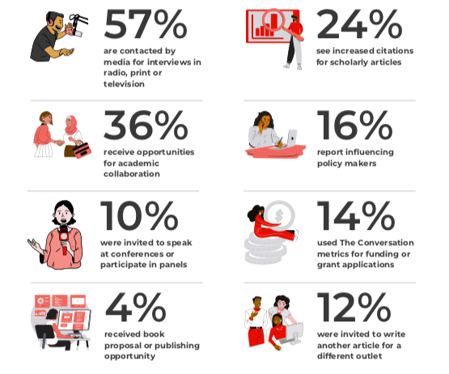
Why write
for us?
We deliver evidence-based information to millions of people.
Amplify academic work by sharing with public through media
Give experts a greater voice and impact in shaping scientific, cultural and intellectual agendas
Research collaborations
Notes:
We know how busy faculty and researchers are and writing is of course a time commitment. And just a quick pitch on the impact you have working with us - not only are you providing a public service, but you are working to sharpen your communication skills and getting valuable training and experience as a public voice. Many of our authors remark on the clarity that working with our editors give to their work, especially since it’s the first time many are writing for the general public. They receive 1:1 professional development with veteran journalist/editors to hone the piece from tone to story structure and more to resonate with the audience.
To start, our model delivers evidence-based information to millions of people. It’s a way to get your work in front of general readers who might not otherwise have access to it and to demonstrate its significance to those readers’ daily lives. It also resonates with the average reader like a young family member.
Writing with us gives also academic experts a greater voice and impact in shaping scientific, cultural and intellectual agendas
Based on a 2022 author survey of more than 600 authors, after writing with us:
Over 70% of our scholars get some kind of additional opportunity after publishing with us
Includes: 57% getting an interview on radio, TV, podcast, in print, etc.
Wide examples of impact - stories being used in congressional offices, being featured in local library newsletters, etc
Training to write for the public - very different from academic writing. Many authors say it helps them in their academic writing after the process. Many people say “I didn’t know this many people cared about what I do.”
Opportunities to collaborate - gets the scholar and the school’s name out there.

Slide 8





Online republishers
The Conversation’s articles are republished by nearly 1,000 online outlets
Top online republishers include:
  Apple News
  Yahoo! News
  Smithsonian
  Business Insider
  Scientific American
  PBS Newshour
  Fortune Magazine
  MSN
Notes:
The beauty of our model is that our content is free to share and distribute through a Creative Commons license. After an article is published on our website, it will be republished by anywhere from 20-60 or more online outlets, which include Yahoo! News, Business Insider, CNN, Fast Company and more niche publications as well. All of our content is also put put through the AP wire. Last year we had over 1,000 online outlets and over 300 print outlets taking our content. We are trying to find people where they are already getting their news.

Slide 9
Print republishers
In 2023, articles by The Conversation have been republished in print over 1,000 times in over 200 different newspapers, including:
  Bismarck Tribune (ND; circ. 38,567)
  Des Moines Register (IA; circ. 38,035)
  St. Cloud Times (MN; circ. 8,262)
  Los Angeles Times (CA; circ. 595,220)
  Washington Post (DC; circ. 288,185)
  Denver Post (CO; circ. 147,119)
  Houston Chronicle (TX; circ. 167,820)
  Huntsville Times (AL; circ. 202,964)
Notes:
Articles by The Conversation have been republished in print over 1,000 times in over 300 those different newspapers

Slide 10
The kinds of stories we publish
News analysis
New research + discoveries
Curiosity pieces
Notes:
All of our stories seek to inform and entertain. Most are 800-1,000 words, but we also publish stories in shorter formats. Here are the three main categories of our stories:

Slide 11
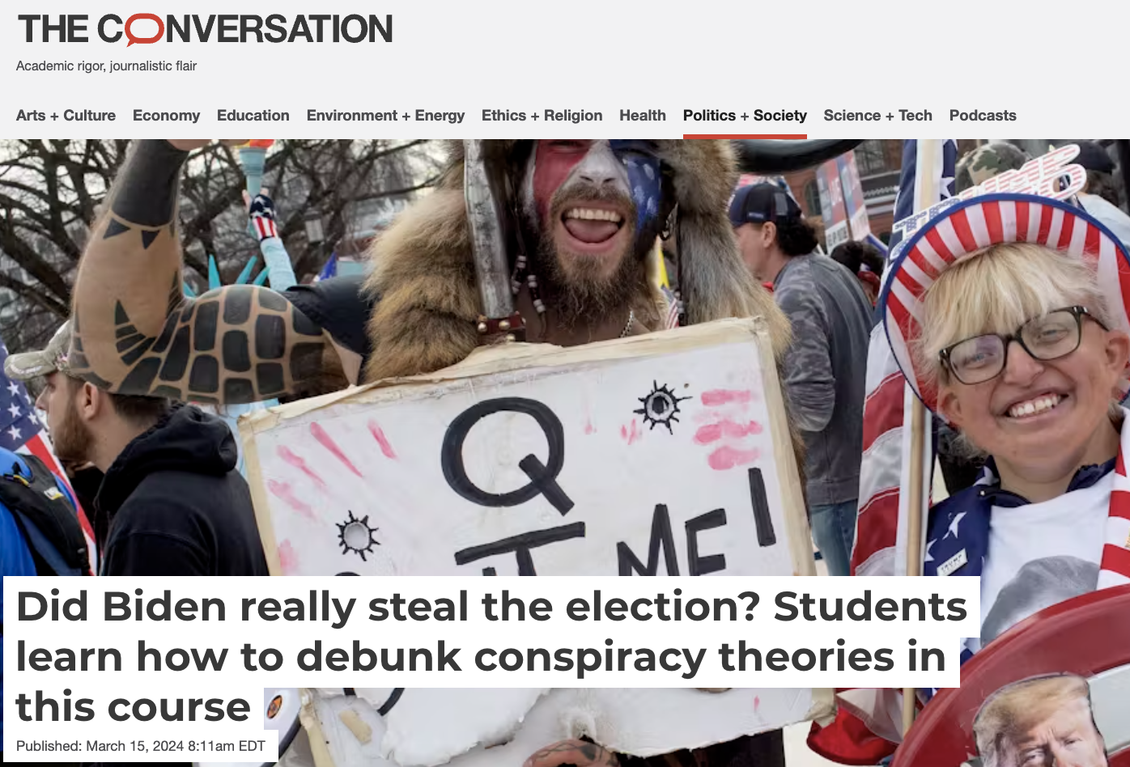
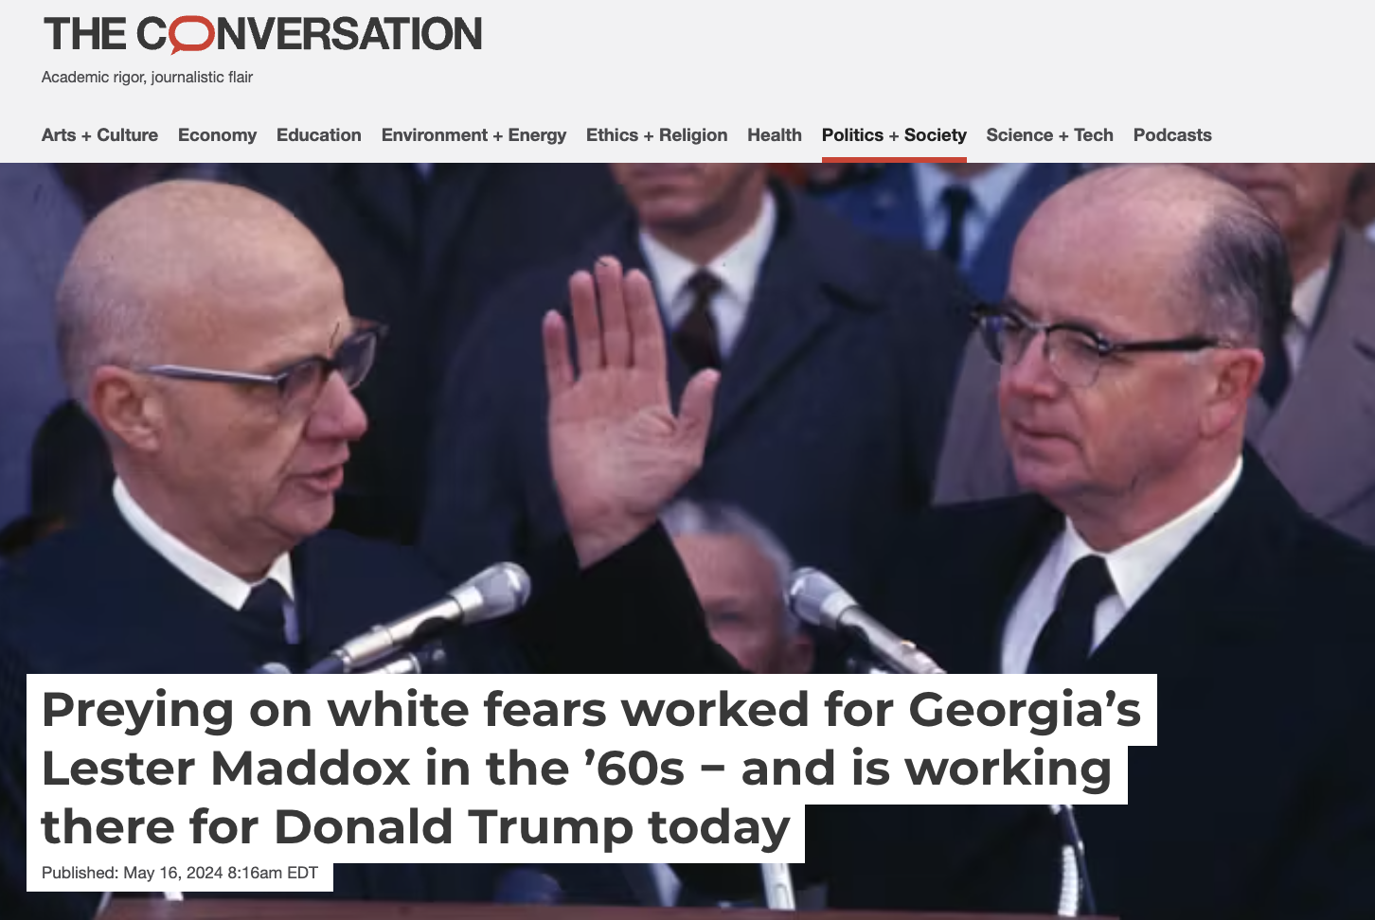
News
analysis
Notes:
More examples from Univ of Iowa
News analysis – add context and deeper insight into events and topics being discussed in the news.
Our bread and butter. Adding commentary and extra context behind the headlines. What’s the thing people aren’t talking about when they talk about X topic in the news? What’s missing? We’re not reporting on the details, we’re adding expertise to the public conversation.

Slide 12

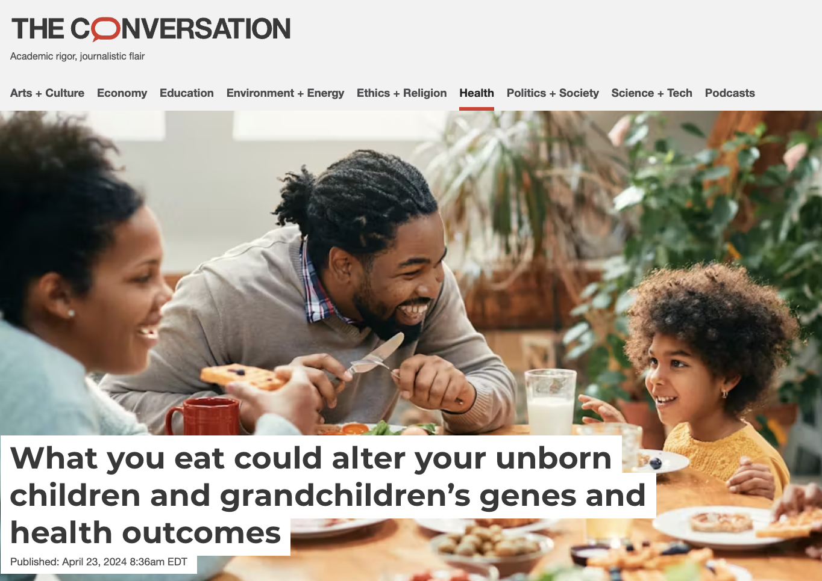
New research + discoveries
Notes:
New research and discoveries – share new research coming out of academia, which includes research coming off embargo

Slide 13
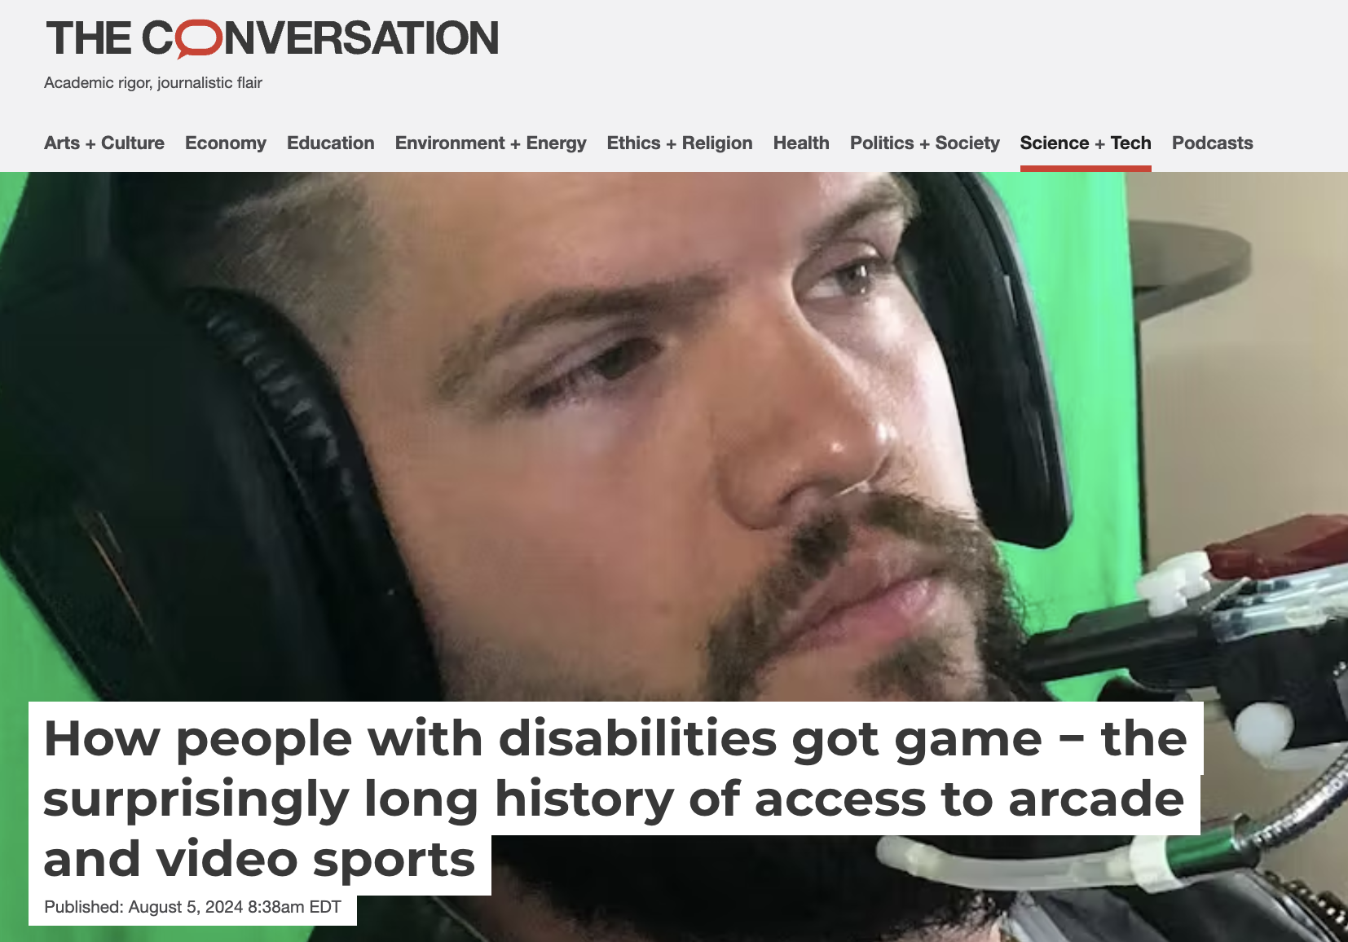
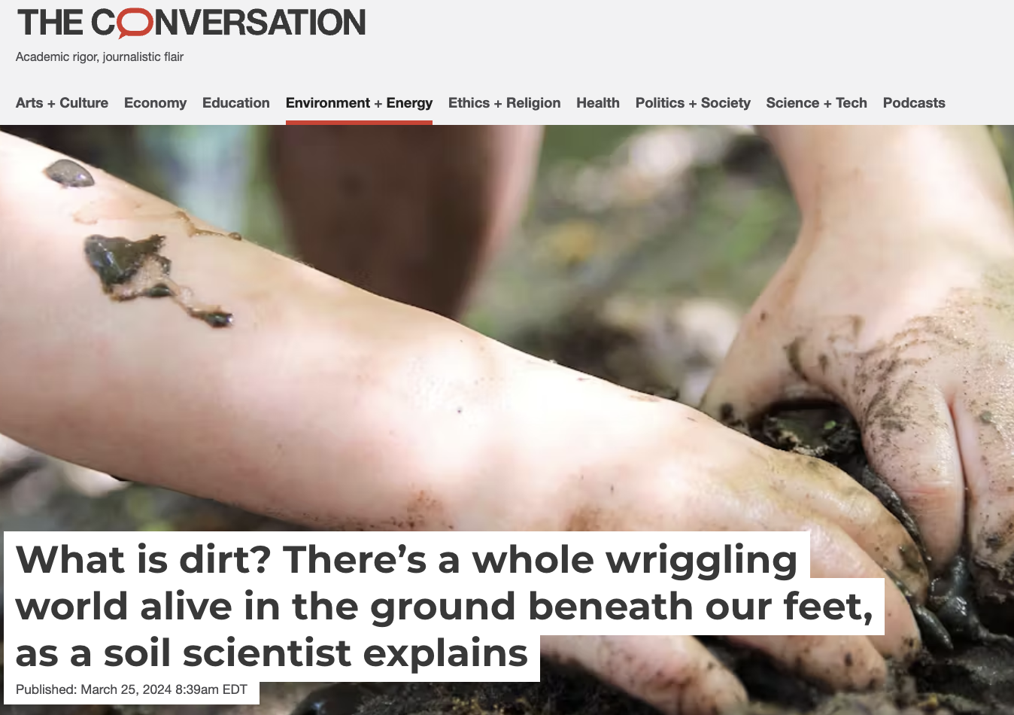
Curiosity
Notes:
Curiosity pieces – pieces that typically answer a simple question that people might be wondering about or give readers a behind-the-scenes look at how interesting work is being done. They’re more “fun” stories that explore questions everyone has. Including but not limited to curious kids - answering “googleable” questions. Should I kill spiders in my house? Should I turn my AC off when I leave my home? What does the Bible say about abortion? While these stories are often on the “fun” side, they also delve into serious topics.
We also have a series called Curious Kids, in which we ask experts to answer a question a real kid has sent to us in a clear, simple and often light-hearted way.

Slide 14
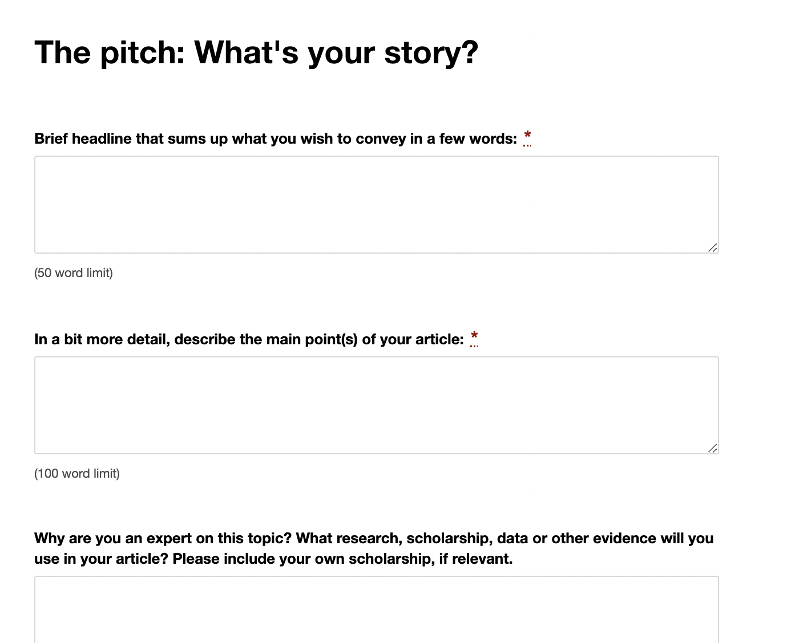
Our pitch form
theconversation.com/us/pitches
Notes:
The process of writing with us starts with a pitch sent via our pitch form. As opposed to a fully written story, a pitch answers a few basic questions about your story idea and your expertise that our editors review and determine if they want to commission.
Here is part of our pitch form, which consists of:
-brief headline that sums up your story idea
-the main point of your story
-your expertise on the topic and what research your proposed story would be based upon
-conflicts of interest
-timeliness
-section
Once you submit it, the desk editor will review the pitch, usually within 5 business days. If your pitch is accepted, you and the editor will have a brief call before you start writing to go over the angle of your story, wordcount, deadline, how to use our system, etc. If the editor is not commissioning, you will get some feedback as to why – for example, a similar story is already in the works or just recently published, the story idea is geared toward a general audience, the pitch reads as an op-ed or advocacy piece, etc.
To access our pitch form, you will need to sign up for an author account on our site.

Slide 15
Brief headline that sums up what you wish to convey in a few words (50 word max)
Summarize your article in two sentences
Sentence 1: What is the takeaway? What will people learn?
Sentence 2: Why does it matter? Why should the general public care?
Example: Global nitrous oxide emissions, a powerful greenhouse gas, continue to rise unabated, driven by unsustainable practices in global food production and growing food demand. The concentration of this GHG in the atmosphere is increasing faster than predicted by the IPCC
Notes:
Our editors consider these main things when they are deciding whether or not to commission a pitch:
Is the story of interest to a general audience? Or why should someone outside of the field and academia care about this story?
Is the story timely? Or why should they care now? (for example, have you published new research or is there an upcoming milestone, event or anniversary coming up that your idea relates to?)
Is the author an expert on what they’re pitching? Another way to think about this is what evidence will the proposed piece be based on?
Can the angle be covered in 1,000 or fewer words? Another way of thinking about this is what is the one story you’re proposing to tell?
reaching out to campus communicators for help

Slide 16
In a bit more detail, describe the main point(s) of your article (100 word max)
What would the subheadings of your article be? (2-4 per article, in general)
What specifics in your research will you be drawing upon? Think specific findings, figures, etc.
Expand upon the answer to your first question. What are the implications of your research for the general public? How will you communicate this to a general audience?
Notes:
Our editors consider these main things when they are deciding whether or not to commission a pitch:
Is the story of interest to a general audience? Or why should someone outside of the field and academia care about this story?
Is the story timely? Or why should they care now? (for example, have you published new research or is there an upcoming milestone, event or anniversary coming up that your idea relates to?)
Is the author an expert on what they’re pitching? Another way to think about this is what evidence will the proposed piece be based on?
Can the angle be covered in 1,000 or fewer words? Another way of thinking about this is what is the one story you’re proposing to tell?
reaching out to campus communicators for help

Slide 17
Example:
• N2O emissions from human activities have increased by 40% in the past four decades.
• Agricultural production (due to the use of nitrogen fertilizers and animal manure) contributed 72% of the total anthropogenic N2O emissions in the last decade.
• N2O accumulation in the atmosphere has accelerated, with growth rates over the past three years (2020-2022) higher than any previous observed year since 1980, and about 30% higher than in the past decade.
• Atmospheric N2O concentration reached 336 parts per billion in 2022, 25% over pre-industrial levels and growing faster than the most pessimistic IPCC scenario.
Notes:
Our editors consider these main things when they are deciding whether or not to commission a pitch:
Is the story of interest to a general audience? Or why should someone outside of the field and academia care about this story?
Is the story timely? Or why should they care now? (for example, have you published new research or is there an upcoming milestone, event or anniversary coming up that your idea relates to?)
Is the author an expert on what they’re pitching? Another way to think about this is what evidence will the proposed piece be based on?
Can the angle be covered in 1,000 or fewer words? Another way of thinking about this is what is the one story you’re proposing to tell?
reaching out to campus communicators for help

Slide 18
Why are you an expert on this topic? What research, scholarship, data or other evidence will you use in your article? Please include your own scholarship, if relevant. (150 word max)
Along with your own research and publications, consider including:
Any public writing you’ve done
Interviews or panels
Chairmanships
Symposiums or presentations
Grants
Supporting research by others that you’ll draw from
Upcoming publications
Notes:
Our editors consider these main things when they are deciding whether or not to commission a pitch:
Is the story of interest to a general audience? Or why should someone outside of the field and academia care about this story?
Is the story timely? Or why should they care now? (for example, have you published new research or is there an upcoming milestone, event or anniversary coming up that your idea relates to?)
Is the author an expert on what they’re pitching? Another way to think about this is what evidence will the proposed piece be based on?
Can the angle be covered in 1,000 or fewer words? Another way of thinking about this is what is the one story you’re proposing to tell?
reaching out to campus communicators for help

Slide 19
Example:
I am the chair of the Global Nitrous Oxide Budget activity under the umbrella of the Global Carbon Project and the International Nitrogen Initiative. I have led the development of the most comprehensive Earth N2O Budgets for the past 10 years contributing to the IPCC assessment reports and the World Meteorological Organization climate reports.
I lead an international research network with contributions from 55 research institutions from around the world in 15 countries to develop such global budgets.
I am a full professor at Boston University, and I have been working on global biogeochemistry, biospheric modelling, and climate change for the past 30 years. I am a Highly Cited Researcher published over 400 papers, and elected Fellow of AGU, ESA and AAAS.
A paper with the new budget will be published by end of May, which we are happy to make available in confidence. A pre-print is available here:
https://essd.copernicus.org/preprints/essd-2023-401/
Notes:
Our editors consider these main things when they are deciding whether or not to commission a pitch:
Is the story of interest to a general audience? Or why should someone outside of the field and academia care about this story?
Is the story timely? Or why should they care now? (for example, have you published new research or is there an upcoming milestone, event or anniversary coming up that your idea relates to?)
Is the author an expert on what they’re pitching? Another way to think about this is what evidence will the proposed piece be based on?
Can the angle be covered in 1,000 or fewer words? Another way of thinking about this is what is the one story you’re proposing to tell?
reaching out to campus communicators for help

Slide 20
What we look for in a pitch
Is the story of interest to a general audience?
Is the story timely?
Is the author an expert on what they’re pitching?
Can the angle be covered in 1,000 or fewer words?
Notes:
Our editors consider these main things when they are deciding whether or not to commission a pitch:
Is the story of interest to a general audience? Or why should someone outside of the field and academia care about this story?
Is the story timely? Or why should they care now? (for example, have you published new research or is there an upcoming milestone, event or anniversary coming up that your idea relates to?)
Is the author an expert on what they’re pitching? Another way to think about this is what evidence will the proposed piece be based on?
Can the angle be covered in 1,000 or fewer words? Another way of thinking about this is what is the one story you’re proposing to tell?
reaching out to campus communicators for help

Slide 21
Not considered a pitch…
A blog post or link to a story that has already been published
“I’m an expert in the field of microeconomics. Do you want me to write for you?”
A press release or grant announcement
An already-written draft
“Our university is part of a consortium that’s studying plant disease X. See this webpage for more information.”
Notes:
These are some examples of things that are not considered a pitch – a blog post or story that’s already been published. A statement of expertise. A press release or grant announcement. An already-written draft of a piece. Or a link to a webpage with more information.

Slide 22
Common reasons pitches are rejected
Too niche/not written for a general reader (jargon)
Not timely
Reads like opinion (or advocacy)
Too speculative
Too broad
Subject not a story
Full draft sent instead of a pitch
We already have a similar piece in the works.
Notes:
And here are some common reasons that pitches are rejected.
(wait a few seconds)
We’re going to go over ways to avoid each of these in depth on the next few slides.

Slide 23





Life cycle of a story
YOU HAVE AN IDEA FOR A STORY.
SEARCH OUR SITE TO SEE IF WE’VE COVERED IT (OR A SIMILAR ANGLE) BEFORE.
IF WE HAVEN’T, PITCH US YOUR STORY VIA OUR PITCH FORM (FOUND ON OUR HOMEPAGE).
IF YOUR PITCH IS ACCEPTED, YOU AND YOUR EDITOR HAVE A PHONE CALL TO DISCUSS THE STORY ANGLE, DEADLINE, WORD COUNT (USUALLY 800-1,000 WORDS) AND ANY QUESTIONS.
AFTER YOUR EDITOR SETS YOU UP IN OUR SYSTEM, YOU WRITE AND FILE YOUR DRAFT IN OUR CMS.
Notes:
This is a little more detail about the process of publishing a story with us, which we share with scholars.

Slide 24

Life cycle of a story
YOUR EDITOR EDITS, FINDS IMAGES AND FORMATS THE STORY.
THEN HE OR SHE SENDS IT BACK TO YOU WITH QUESTIONS AND CHANGES (THIS TYPICALLY TAKES A FEW ITERATIONS AND INCLUDES A SENIOR EDITOR AND COPY EDITOR’S REVIEW).
ONCE YOU APPROVE THE STORY, WE PUBLISH IT ON OUR SITE.
WE THEN SHARE IT WITH OUR REPUBLISHERS FOR ADDITIONAL MEDIA PICKUP, HELPING YOUR STORY REACH AS MANY READERS AS POSSIBLE.

Slide 25
